Slide 1

Laptop Price Prediction
What Factors Affect Laptop Computer Prices?

Slide 2
Business Problem
Several different factors can affect laptop computer prices. These factors include the
brand of computer
the amount of memory
the speed of the processor can also affect pricing.
Though less common, some consumers spend additional money to purchase a computer based on the overall “look” and design of the system.

Slide 3
Business Problem
In many cases, name brand computers are more expensive than generic versions. This price increase often has more to do with name recognition than any actual superiority of the product.
One major difference between name brand and generic systems is that in most cases, name brand computers offer better warranties than generic versions. Having the option of returning a computer that is malfunctioning is often enough of an incentive to encourage many consumers to spend more money.

Slide 4

Data Understanding
An in depth look at our data

Slide 5
Data Understanding
In our dataset we have the following columns:
Manufacturer: Brand
Model name: Model name/ Number
Category: type of laptop
Screen Size: screen size in inches
Screen: screen type
CPU: CPU type
RAM: RAM quantity
Storage: storage capacity
GPU
OS
OS version
Weight
Price

Slide 6
Data Understanding
Looking at the columns we find that all the data are categorical except the price its represented as a float number.

Slide 7
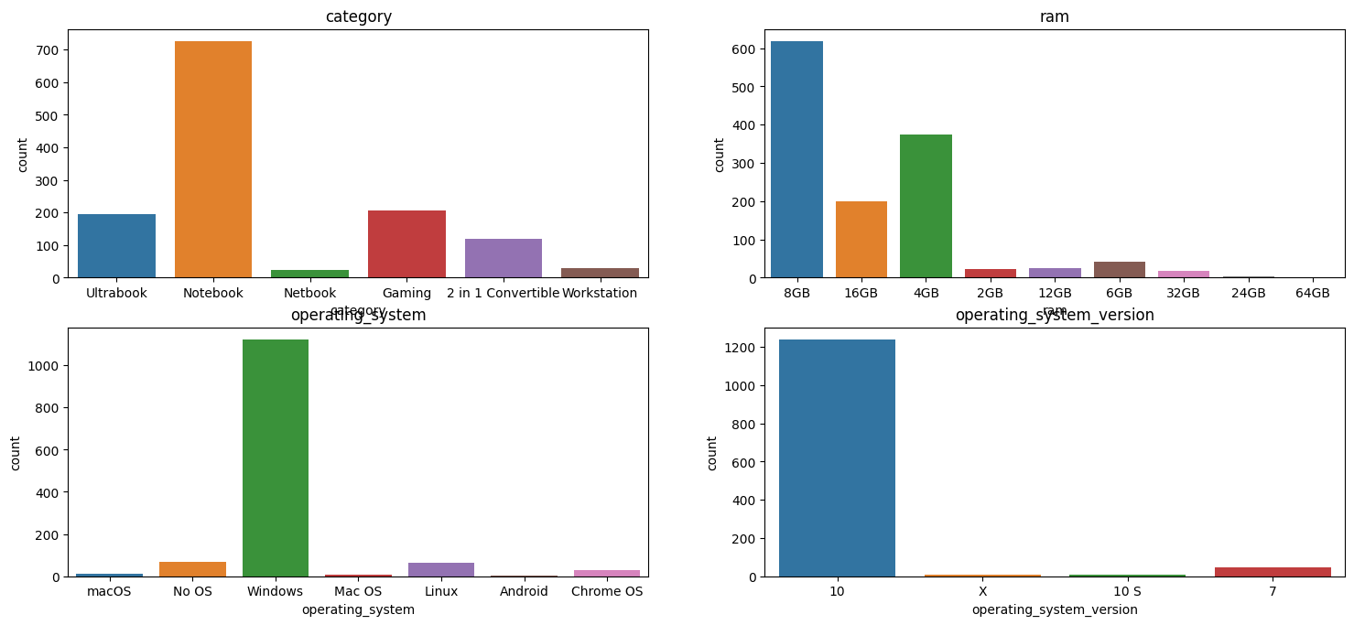
Data Understanding
we will look at some of the features’ distribution in the data

Slide 8
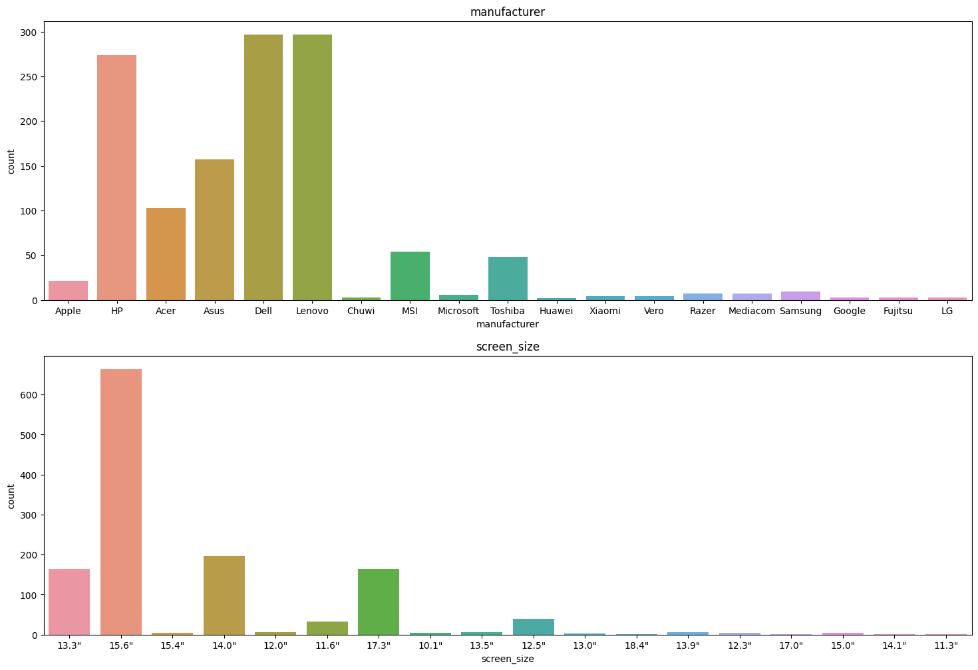
Data Understanding
we will look at some of the features’ distribution in the data

Slide 9
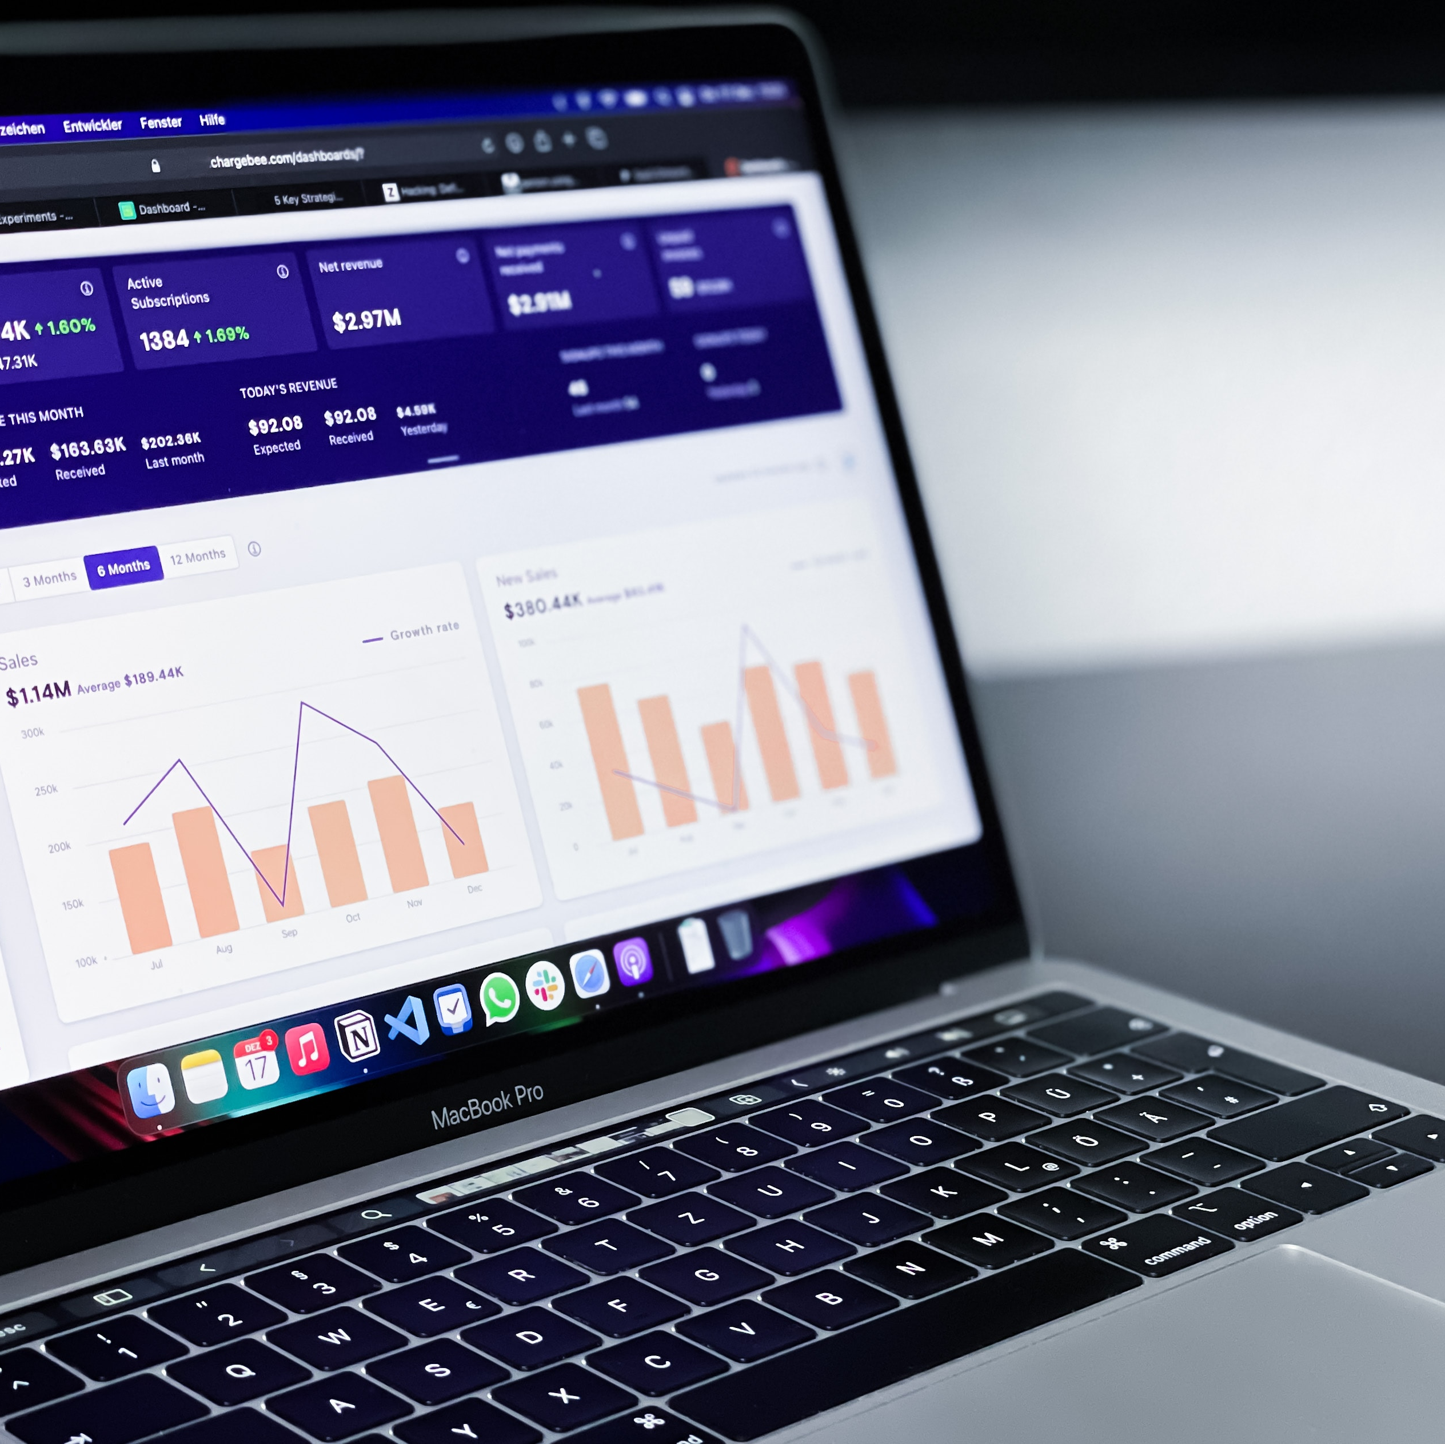
Data Understanding
Looking at some top 10s

Slide 10
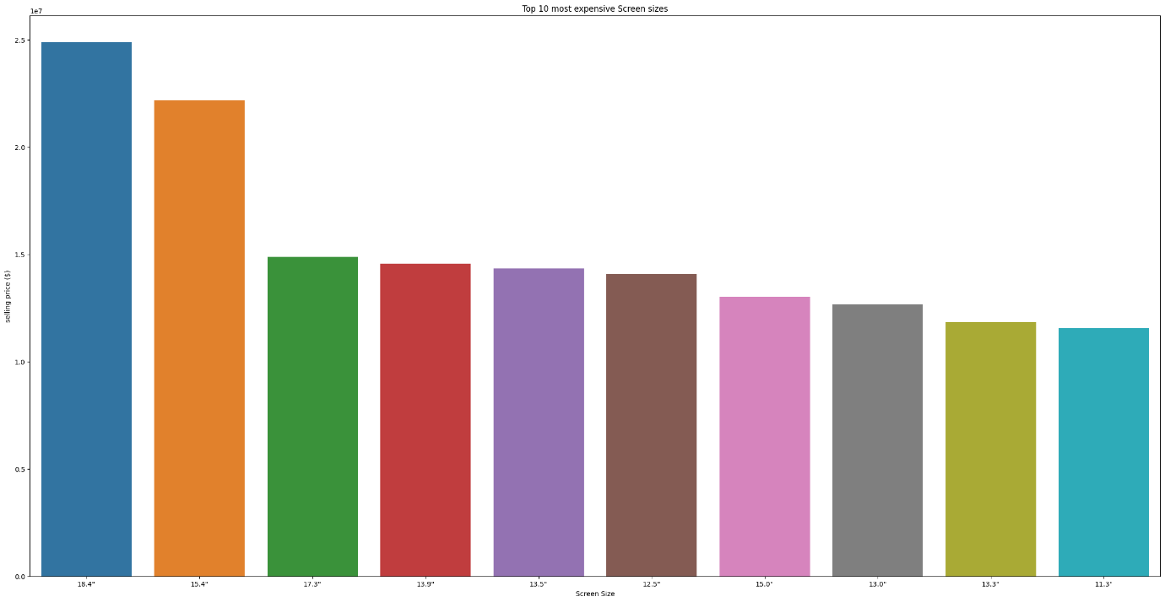
Data Understanding
Top 10 most expensive screen sizes

Slide 11
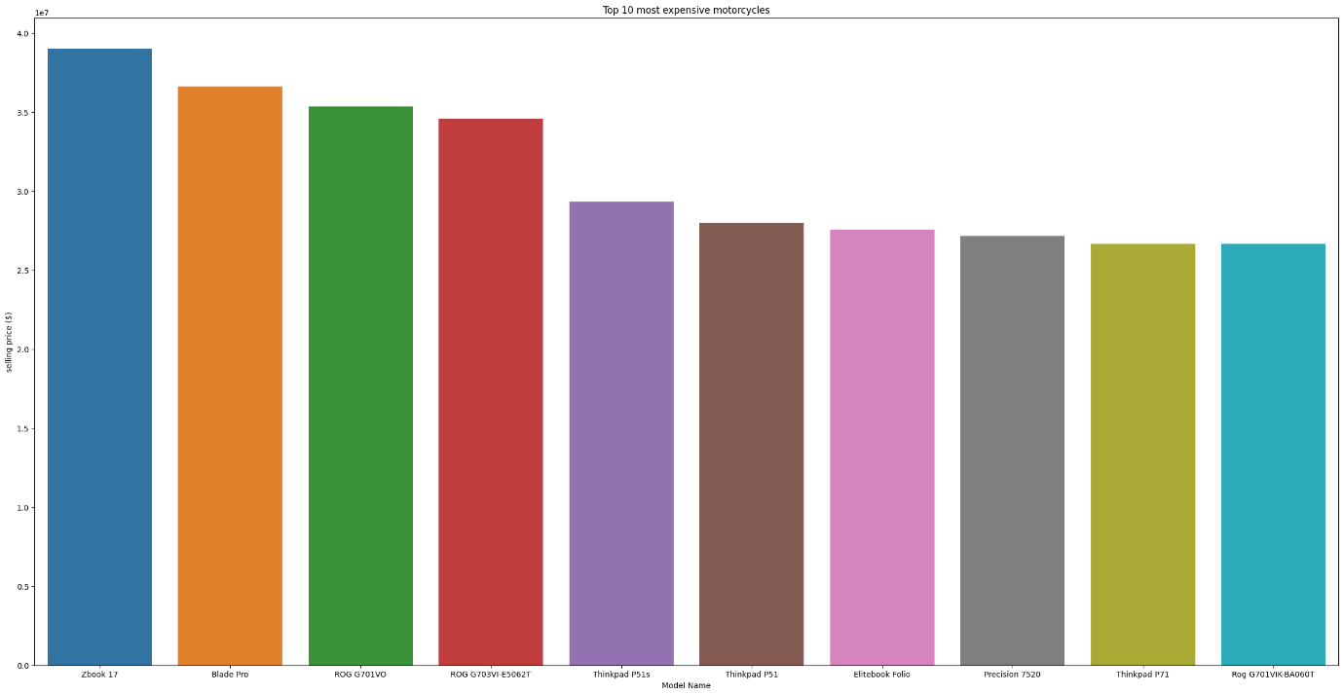
Data Understanding
Top 10 most model name

Slide 12
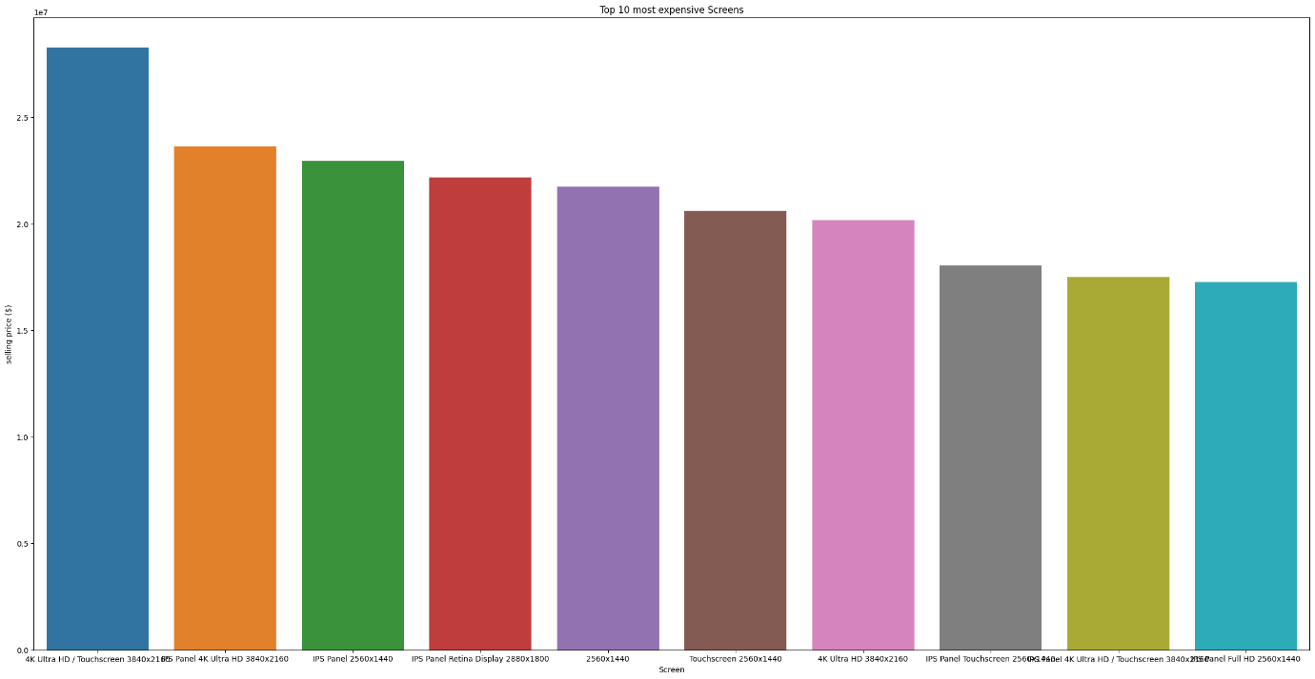
Data Understanding
Top 10 most expensive screen

Slide 13
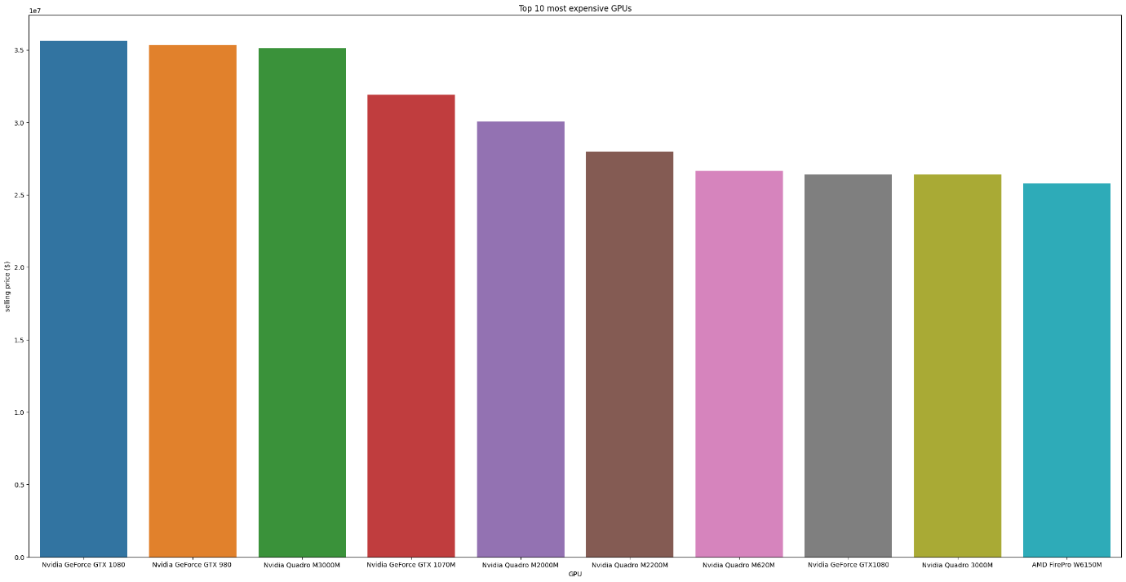
Data Understanding
Top 10 most expensive GPUs

Slide 14
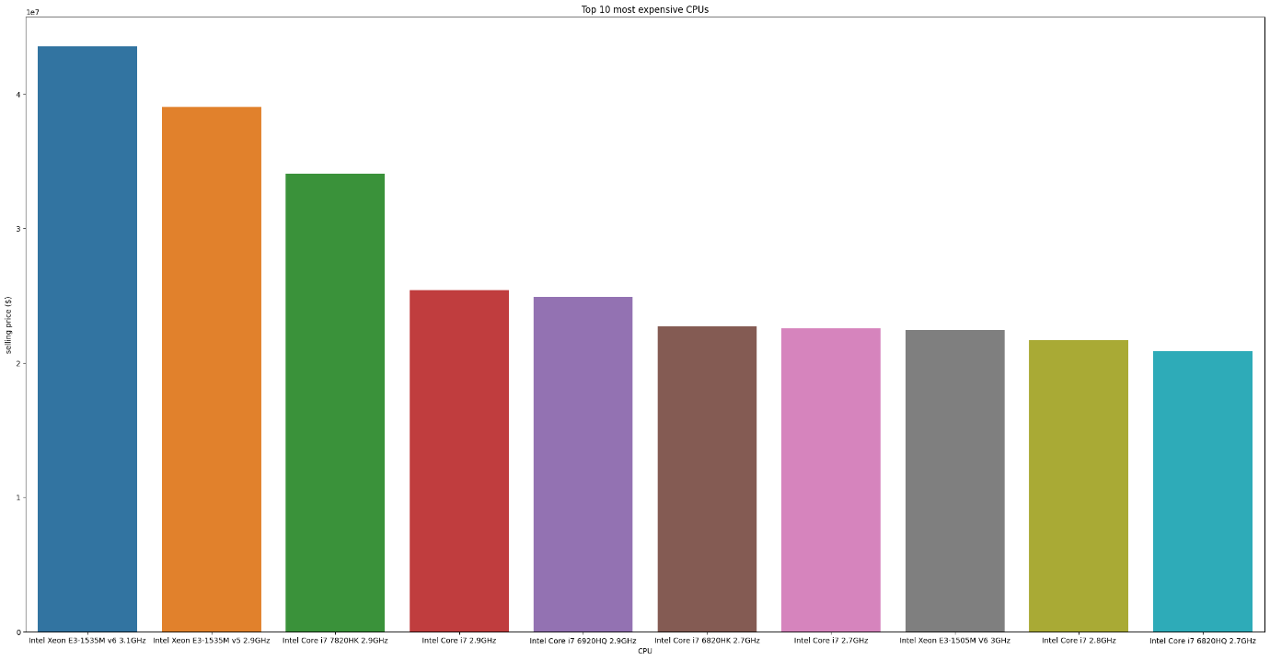
Data Understanding
Top 10 most expensive CPUs

Slide 15
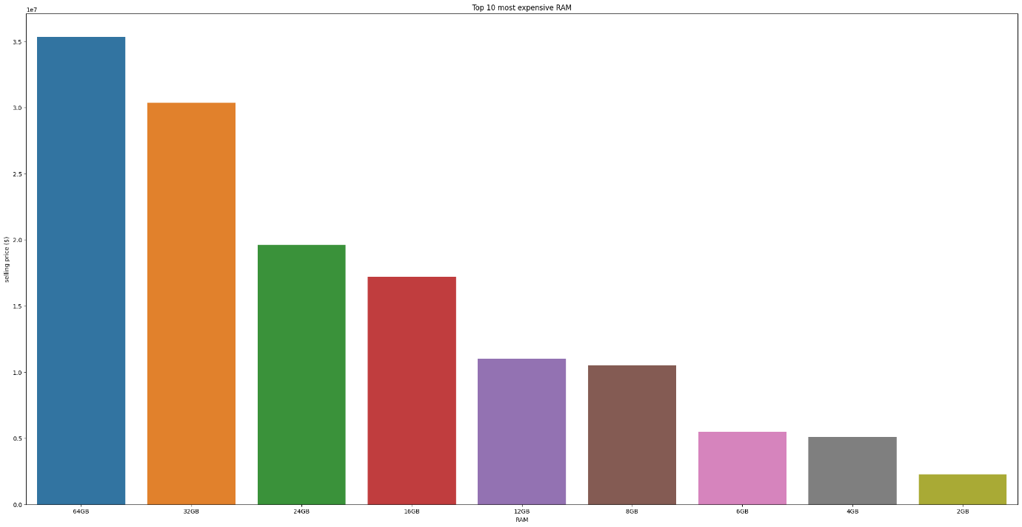
Data Understanding
Top 10 most expensive RAMs

Slide 16
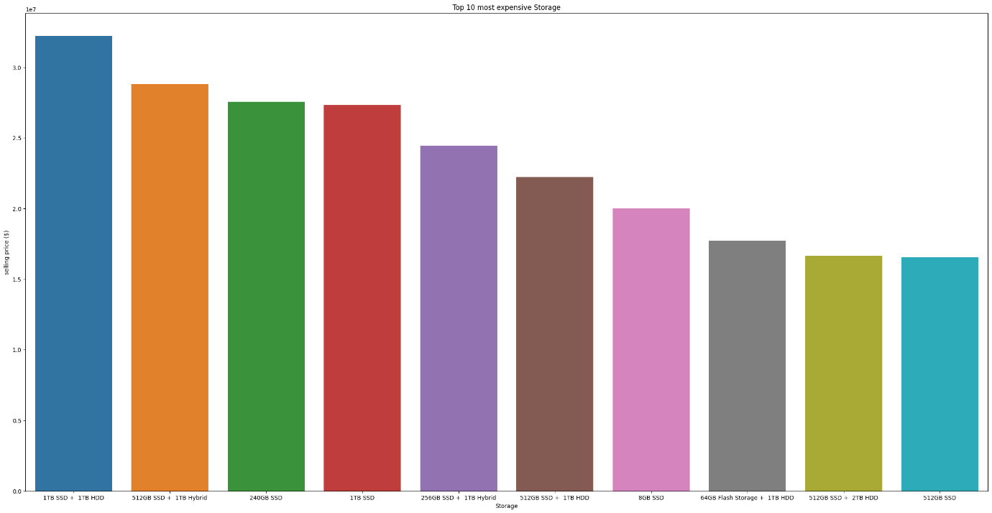
Data Understanding
Top 10 most expensive Storages

Slide 17
Data Preparation

Slide 18
Data Preparation
We will first find the number of missing values.
It turns out that OS version column has 170 missing values and since it’s a categorical column we will fill the missing data with the mode
Filling the missing values

Slide 19
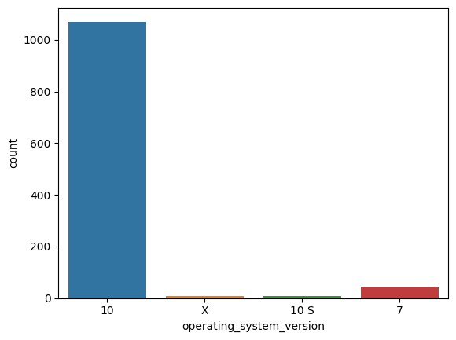
Data Preparation
A counter plot before filling the missing data with mode
Filling the missing values

Slide 20

Data Preparation
A counter plot after filling the missing data with mode
No big Difference
Filling the missing values

Slide 21
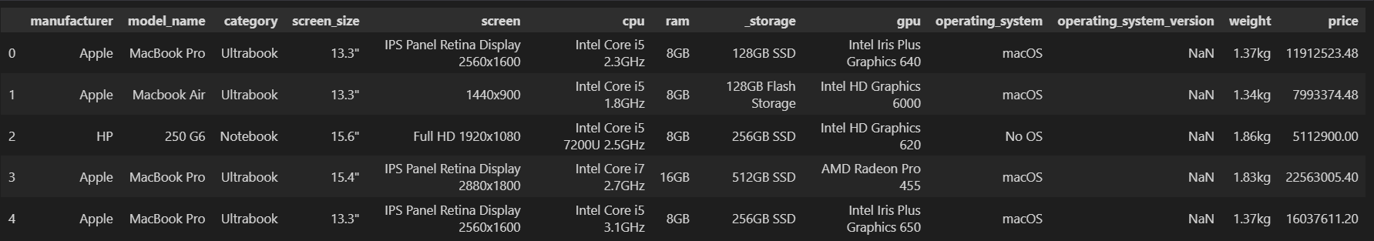
Data Preparation
Looking at the weight column we will notice that it’s a categorical column we will change it to be a float column
Modifying the weight column

Slide 22

Data Preparation
visualising some features according to price

Slide 23
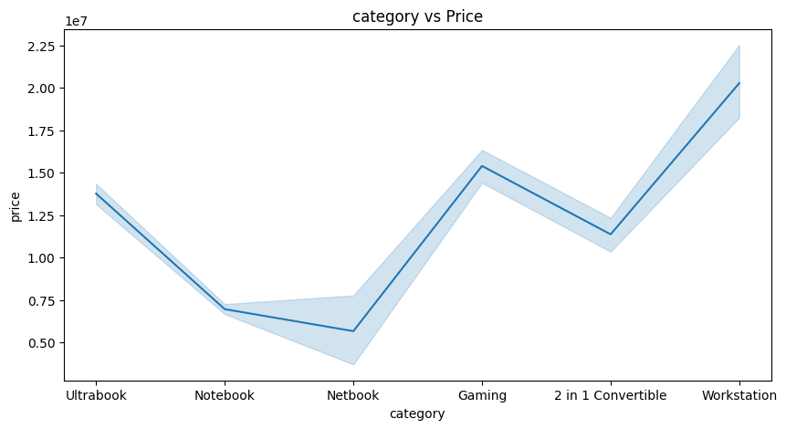
Data Preparation
Looking at the categories visualization we can find that the most expensive category is the workstation and the most cheap category is the netbook
Category vs price

Slide 24
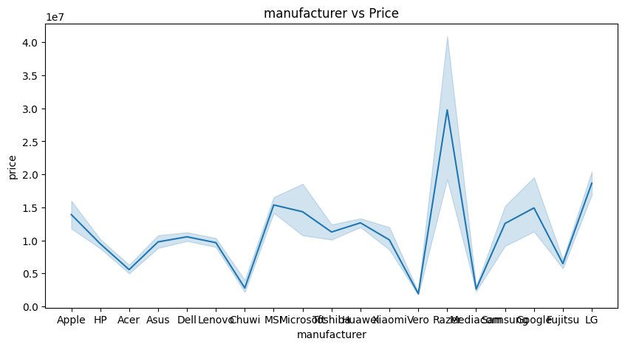
Data Preparation
Looking at the manufacturer visualization we can find that the most expensive manufacturer is Raze
manufacturer vs price

Slide 25
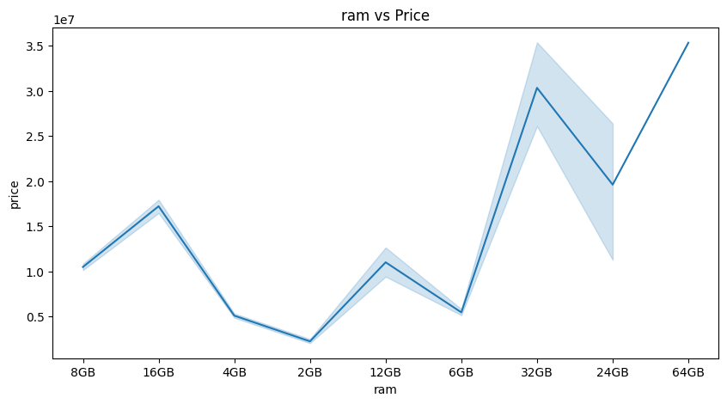
Data Preparation
Looking at ram visualization we can find that whenever the number of ram increased the price increases
RAM vs price

Slide 26
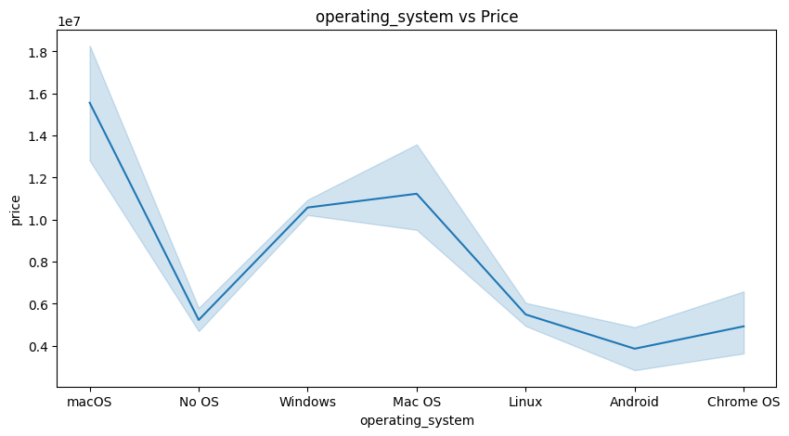
Data Preparation
Looking at the OS visualization we can find that the most expensive OS out there in the market is the macOS and the cheapest is Android and chrome OS
OS vs price

Slide 27
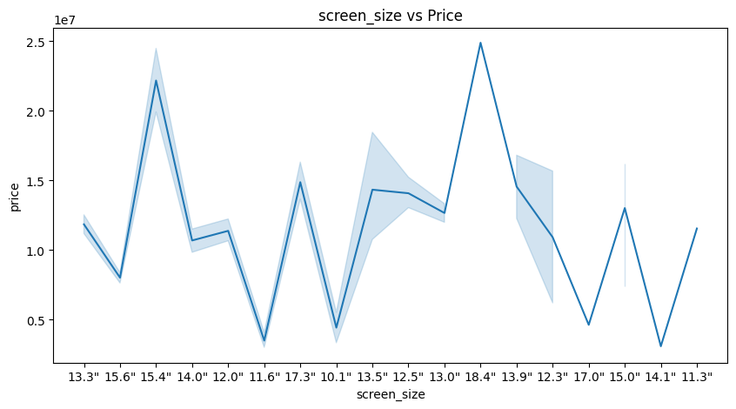
Data Preparation
Screen Size vs price

Slide 28
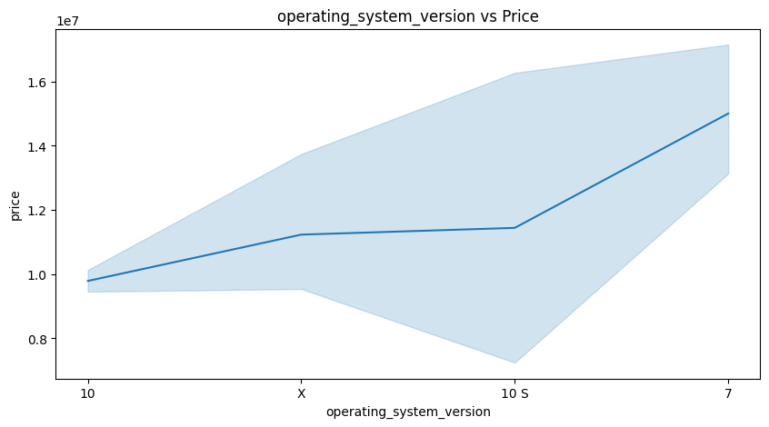
Data Preparation
OS version vs price

Slide 29
Data Preparation
We might ask ourselves does the wight of the laptop affects the price.
When the weight of the laptop decreases, does its price increase, and vice versa?
To answer that question we will find a correlation between the weight and the price.
We find that the correlation is 0.210166, that means that there is no correlation between the weight and the price
A business question about weight

Slide 30
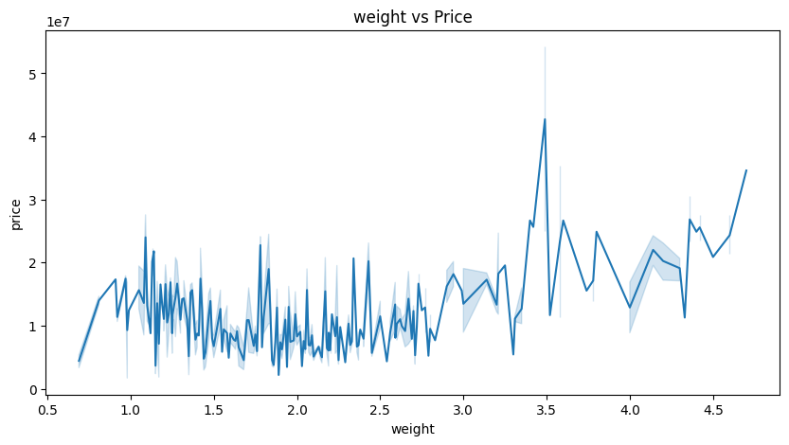
Data Preparation
Weight vs price

Slide 31
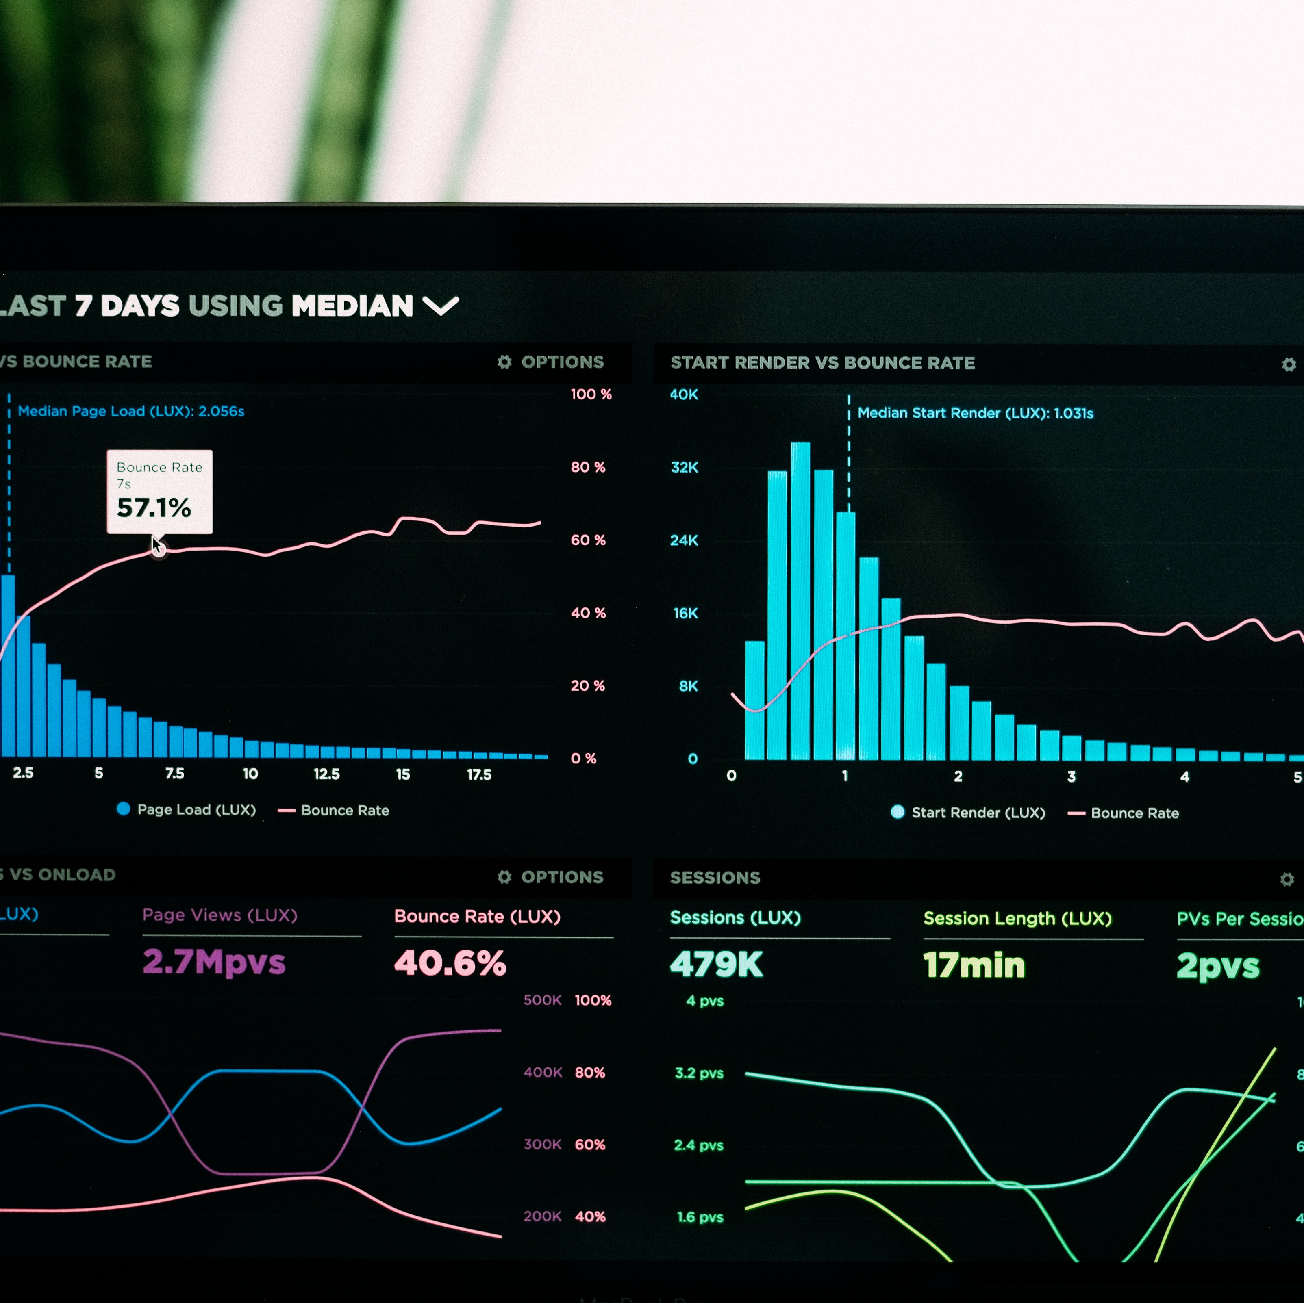
Data Preparation
identifying the weight and price outliers

Slide 32
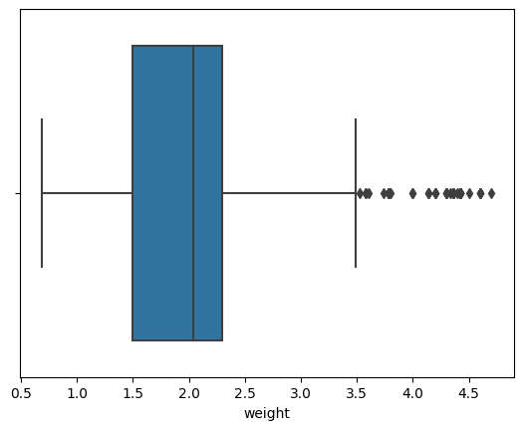
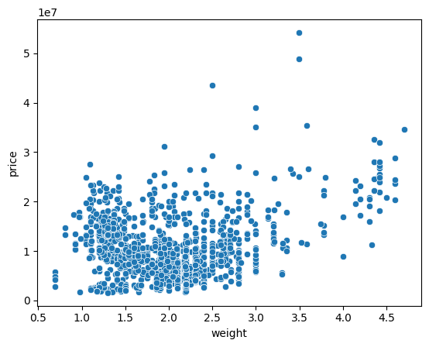
Data Preparation
Looking at weight outliers

Slide 33
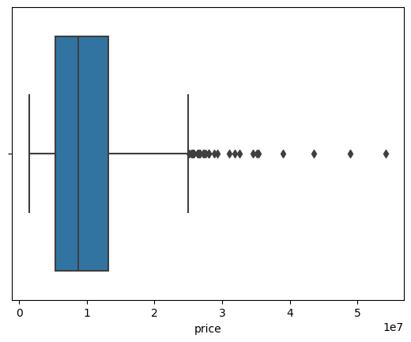
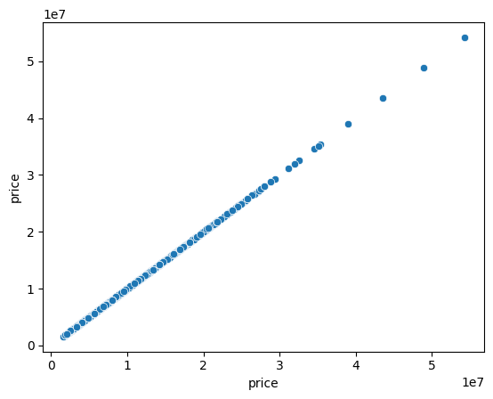
Data Preparation
Looking at price outliers

Slide 34
Data Preparation
we can find that there are some outliers (very few) so we decided to leave them
Conclusion

Slide 35

Models Used

Slide 36
Models Used
First we decided to use the label encoder to transfer the categorical data to quantitative data, then we standardized the data using the standard scaler
Standardizing

Slide 37
Models Used
We used 4 models for this dataset to predict the laptops prices:
Multiple Linear Regression
SVR
Decision Tree
Random Forest Tree

Slide 38
Models Used
Using Multiple Linear Regression Model we got the following accuracy 0.47735026637575984 using r2 score which is not a very good score to predict the prices
Multiple Linear Regression

Slide 39
Models Used
Using SVR Model we got the following accuracy 0.6484854273556406 using r2 score which is better score compared to Multiple linear regression
SVR

Slide 40
Models Used
Using Decision Tree Model we got the following accuracy 0.7844133322185274 using r2 score which is actually a good score compared to the previous scores
Decision Tree

Slide 41
Models Used
Using Random Forest Tree Model we got the following accuracy 0.8407866564181473 using r2 score which is by far the best accuracy we got compared to the previous scores and a really good accuracy to predict the prices
Random Forest Tree

Slide 42

Thank you

